Slide 1



Ocean Inc.
The Oceanic-Industrial Management Game
by Group 1: Diego Bravo, Nick Filipov, Alejandro Bravo, Jose Bolanos

Slide 2
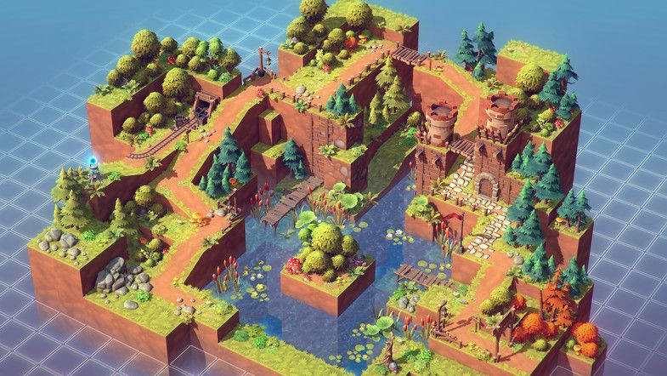
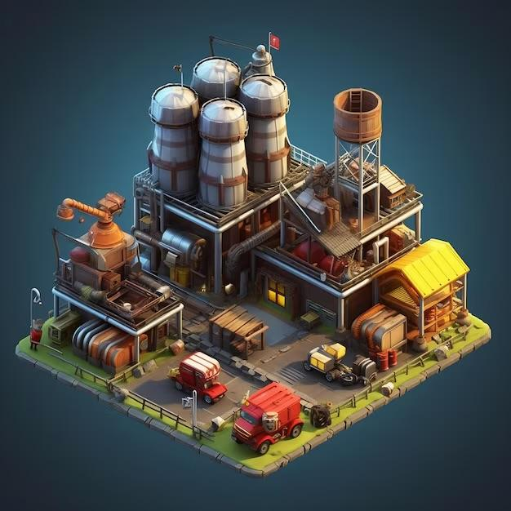
Project Overview
This will be an industrial management game set in the ocean or coast.
Player must expand their factories, build oil rigs, dispose of waste, and generate wealth to grow an industrial empire. Meanwhile, the sea level rises and rapidly generates industrial-sourced pollution in the ocean.
The objective of the game changes once the player has caused enough damage to the Earth’s oceans.
Player must mitigate or remediate the damage, otherwise the environmental effects will destroy their factories.
Notes:
Diego

Slide 3
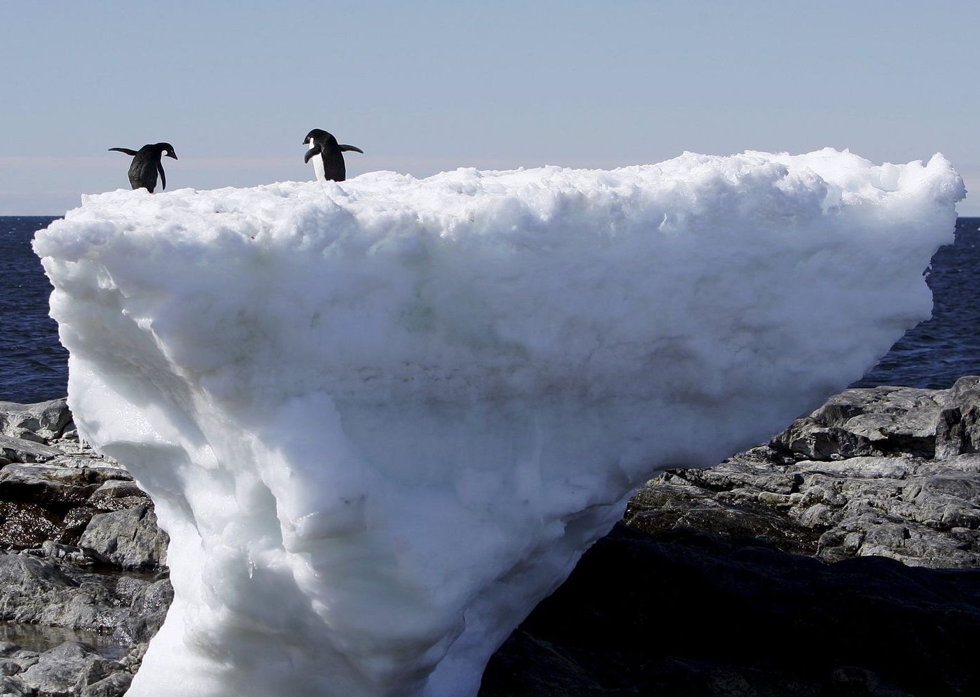
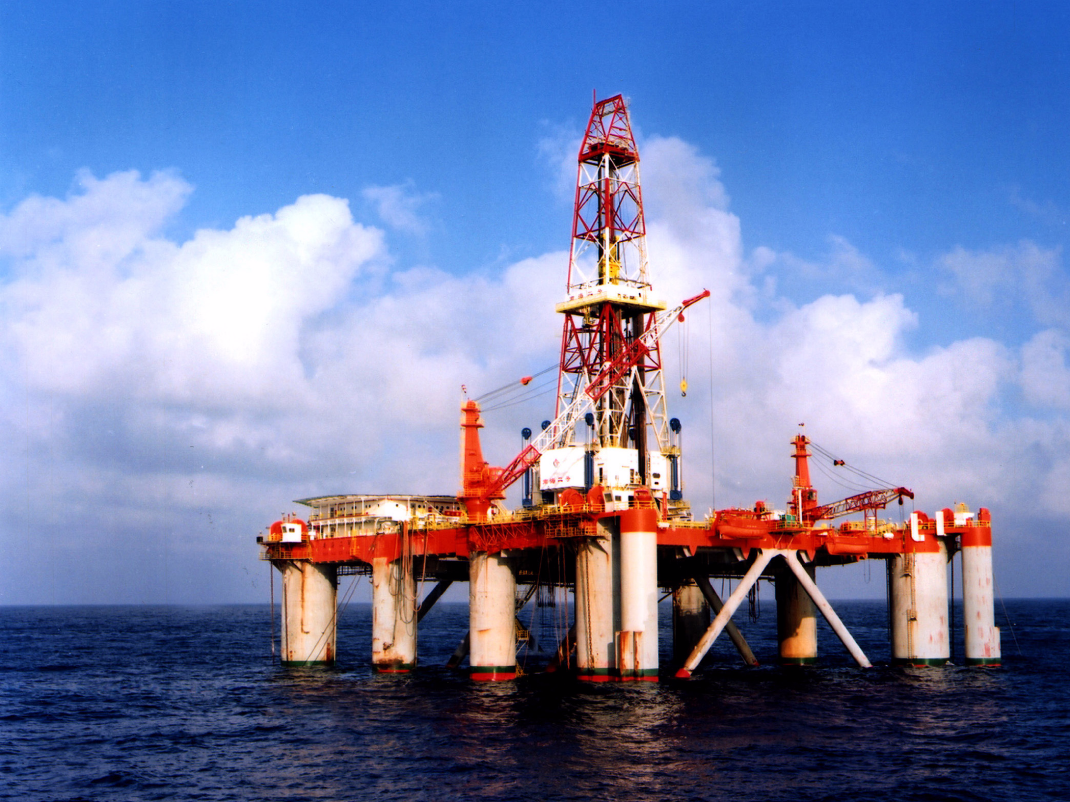
Purpose
According to NASA.gov, ice sheets are decreasing by the 100 billions in metric tons every year. This is due to human-driven climate change following the Industrial Revolution.
Game brings awareness to the sea level rising and rapidly generating industrial-sourced pollution in the ocean.
Notes:
Diego

Slide 4

Scope of the Work
This game will be developed by a large game studio.
Due to all of the game design, coding, and research needed the game development process will take a couple of years to develop.
Game development will include 3D artists, game designers, programmers, environmentalists, etc. to make the game accurate and well designed.

Slide 5
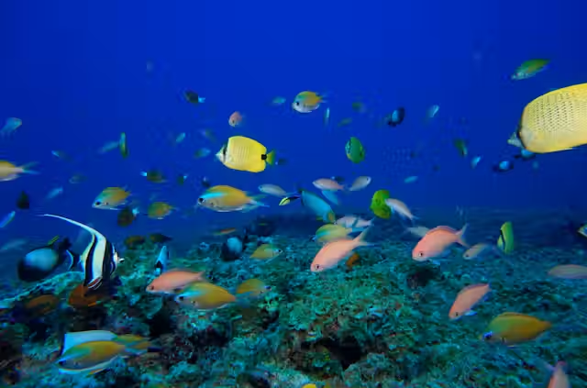
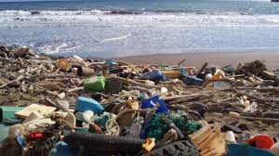
Scope of the Product
Early Industrial Expansion
Set up factories, build oil rigs, and manage resources to grow your industrial empire while causing minimal initial environmental impact.
Pollution Crisis
Address increasing waste management challenges, balancing cost and environmental damage as pollution starts threatening marine life and sea levels.
Environmental Remediation
Mitigate environmental damage through sustainable practices and cleanup efforts, or face the destruction of your industrial empire due to ecological collapse.

Slide 6

Stakeholders
Stakeholders could be different environmental organizations.
The client is a game development studio looking to make an educational game that teaches how different types industrial growth effects the oceans in good and bad ways.
The customer would be people who want a fun and interactive way to learn about the consequences of different types of industries on the oceans.
Technicians will maintain the game, fix bugs, manage software update, and more.
Notes:
Nick

Slide 7

Mandated Constraints
Development Constraints
Optimizing the game so it runs on most gaming platforms.
Game is able to be built on chosen gaming development platform.
Making the game with a reasonable sized money budget.
Meeting deadlines for game progress.
In-Game Constraints
Game provides accurate information about the effects of environmental damage to oceans.
Introduce random environmental events to keep the gameplay engaging for players.
Notes:
Nick

Slide 8
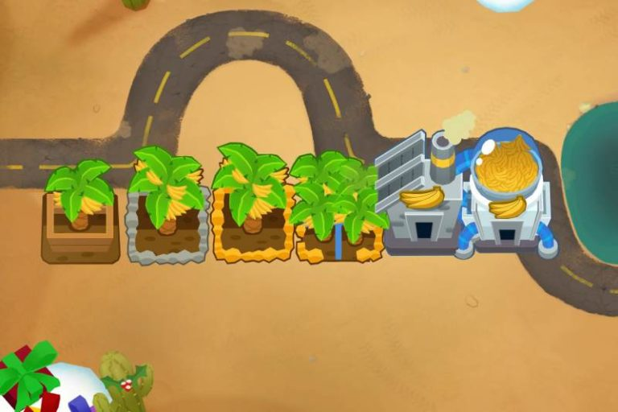
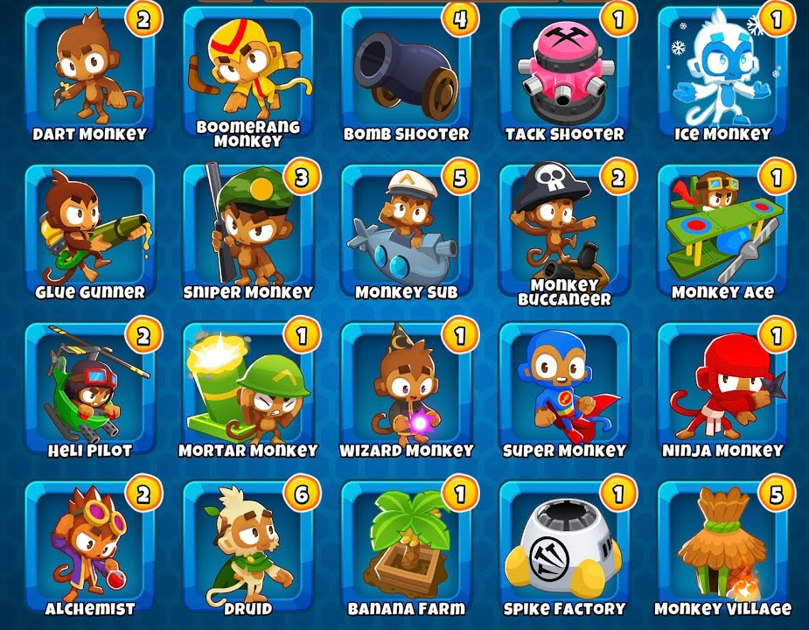
Naming Conventions and Definitions
Factories - Buildings that the player can build which will either make them money, gather resources, or create products.
Playable Area - The space that the player can build factories.
Build Menu - A menu that contains the different factories available to build.
Pollution Meter - A meter that displays how much pollution the factory is producing.
Upgrades - Factories can be upgraded in different ways to increase productivity or reduce pollution.
Notes:
Alejandro

Slide 9
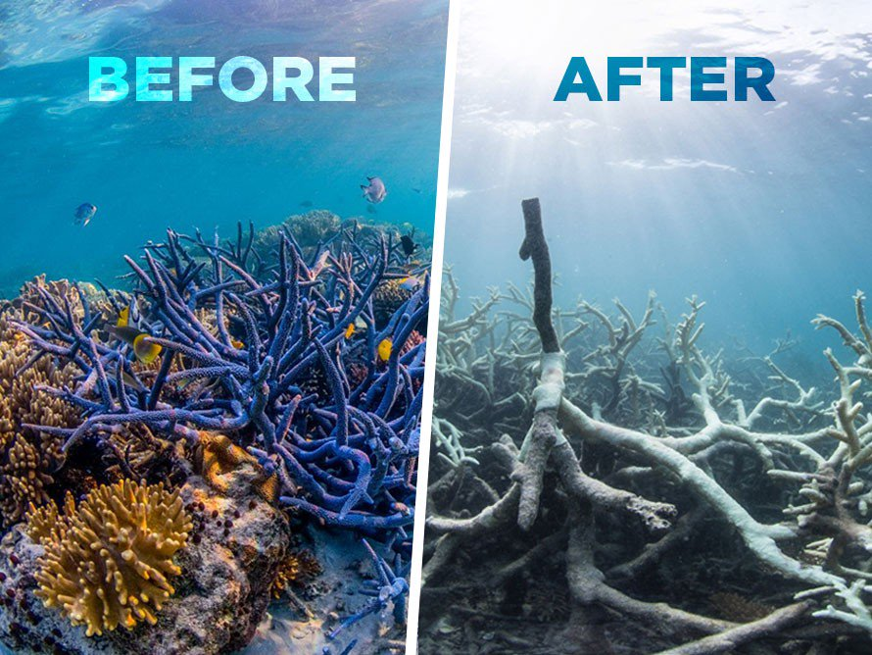
Relevant Facts and Assumptions
Census data from websites like NASA will be pulled in order to try to make the game realistic as possible.
Climate data will be collected in order to make industry factories show real effect in game.
Players will be able to assume their industrial actions have consequences.
Images of climate change effects will be used in to make in-game effects.
Notes:
Alejandro

